Slide 1
yFuzz: a yield-driven progressive fuzzer for stateful communication protocols
Yurong Chen, Tian Lan, Guru Venkataramani

Slide 2


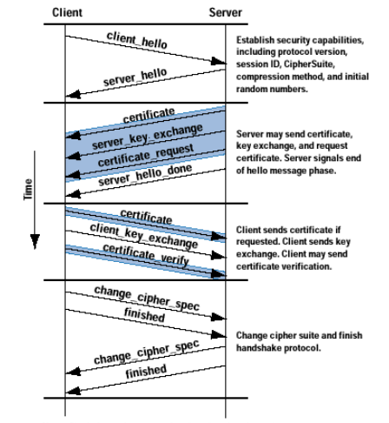

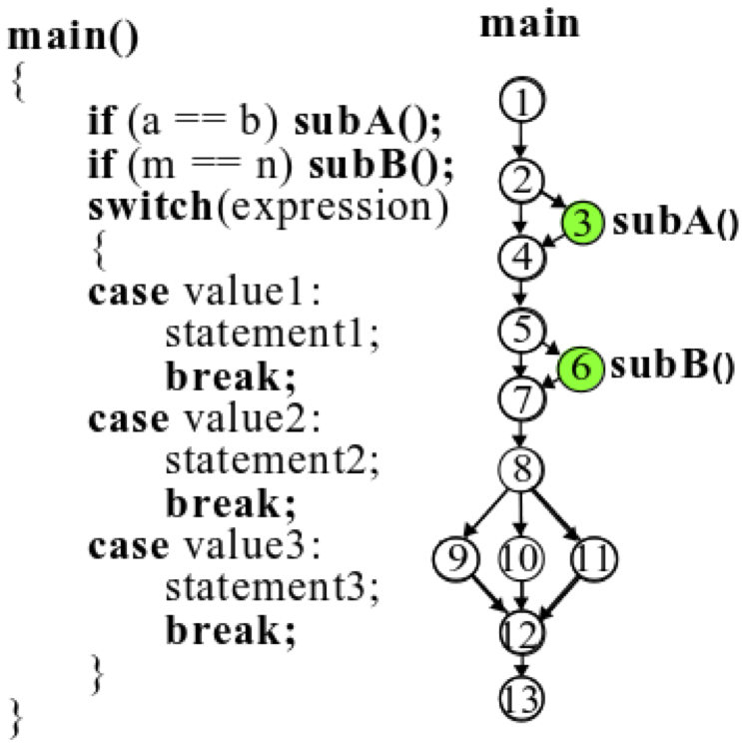
Fuzzing communication protocols
Protocol Fuzzer
Program
Fuzzer
Test Input
S₀
a:hello
S₁
b:certificate
c:key
S₂
c:key
S₃
Server State Machine
Protocol fuzzing faces some very unique challenges:
Most communication protocols are stateful, so fuzzing should be state-aware
They involve multiple entities communicating with each other
Many packets/fields are interdependent and thus cannot be fuzzed separately

Slide 3


AFL Forkserver
Developed to avoid repeated “execv()”, which is an expensive syscall. Instead, use “fork()” to spawn new fuzzing instances
1: Fuzzer forks a child process fork server (FS)
2: FS forks each child process to run testing program (TP)

Slide 4
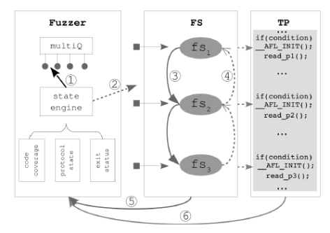
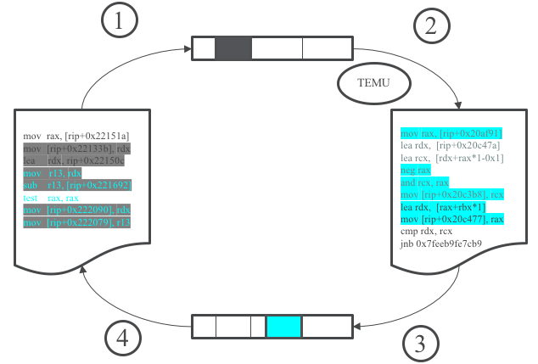
Our Solution: Progressive Protocol Fuzzing
State forking & replay
We propose a “dynamic state forking and replay” mechanism to
build multiple fuzzing states across the test program execution and switch between them.
replay any critical point of execution and mutate relevant packets, while maintaining protocol state consistency.
enable various fuzzing strategies such as “onion peeling”, “drill through”, and “greedy”.
Packet 1
S₁
Packet 2
S₂
Packet 3
S₃
Cross-host tainting

Slide 5
System design

Slide 6


State-aware fuzzer
Non-stateful:
State-aware:
Q1
Input 1
Input 2
Input 3
Input 1
Input 2
Input 3
Input 4
Q2
State
Engine
Input 1
Input 2
Input 3
Q3
Input 1
Input 2
Input 3
Feedback
COV
COV
Input 1’
Input’

Slide 7
Stateful fuzzing engine

Slide 8
Communication
Communication among fuzzer, forkserver and testing program
1
Fuzzer signals FS to fork through pipe
2
FS receives signal
3
FS informs TP about fuzzing state
4
TP reads fuzzing state
5
TP writes fuzzing state
6
Fuzzer reads COV
7
Fuzzer reads TP ret status from pipe
8
FS writes TP ret status to pipe

Slide 9
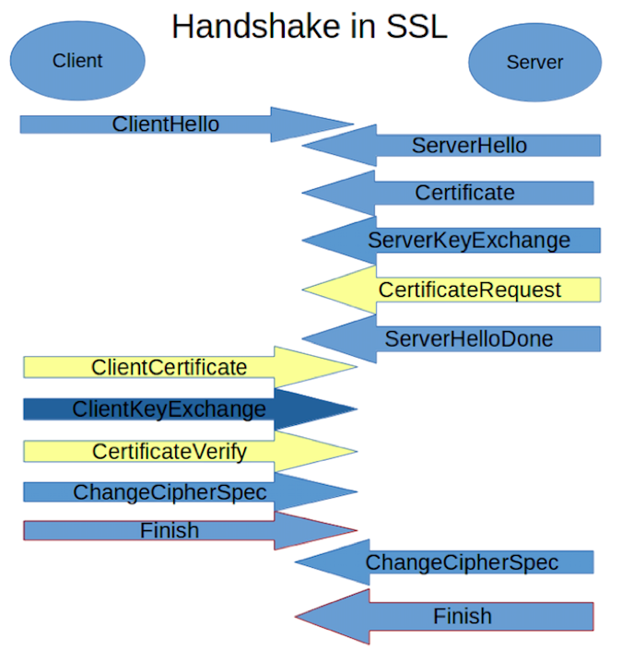
Evaluation on SSL Protocol
A standard protocol for authentication and creating a secure connection.
Running in server/client mode.
Authentication through handshakes.
Also allowing other functionalities such as selecting cipher suites and deriving shared keys
Typically four flights in the handshake
Many vulnerabilities of OpenSSL are well documented in CVE and serve as ground truth.
Heartbleed (CVE-2014-0160)
17% of the Internet's secure web servers certified by trusted authorities were vulnerable to the attack

Slide 10
Implementation upon AFL

Slide 11
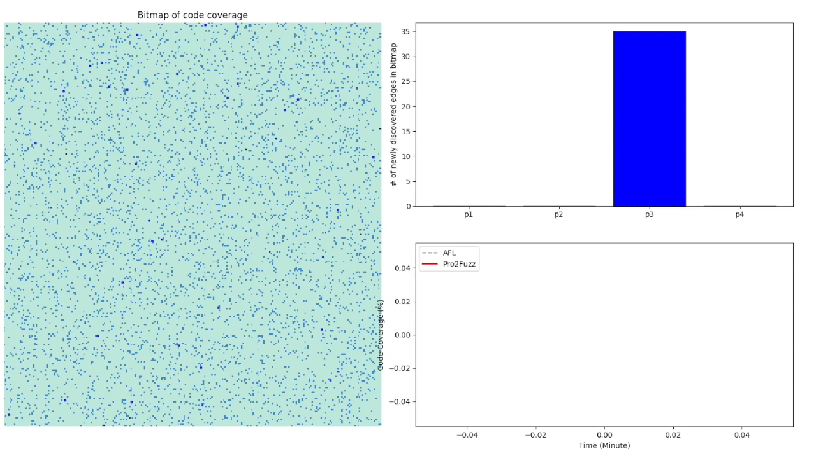
Demo 2
Demo

Slide 12
Code coverage breakdown

Slide 14
Performance comparison

Slide 15
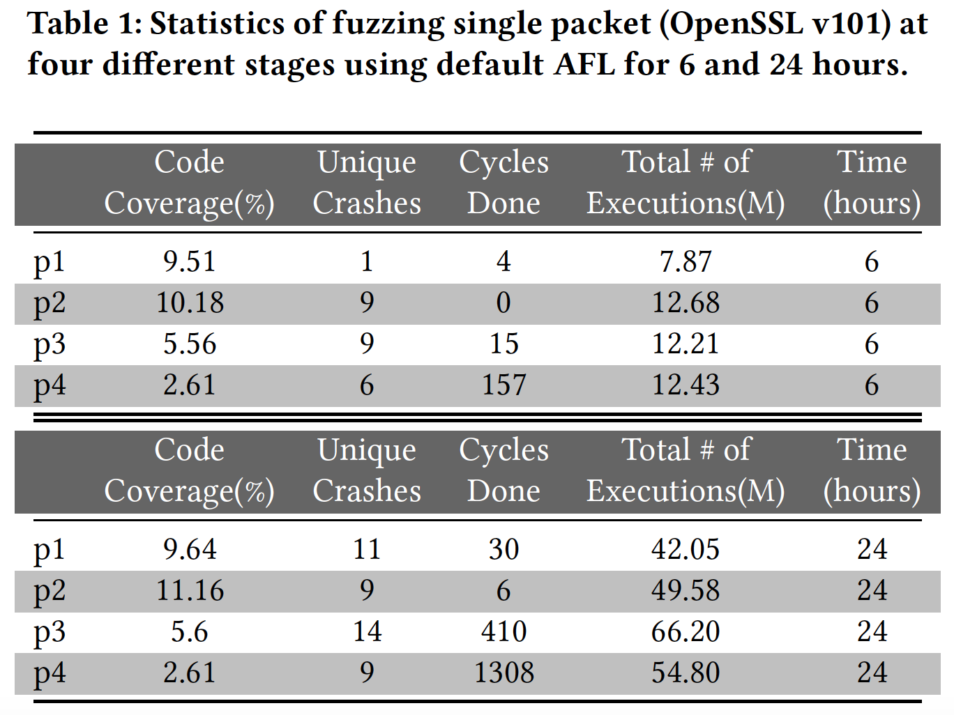
Single packet fuzzing
OpenSSL

Slide 16
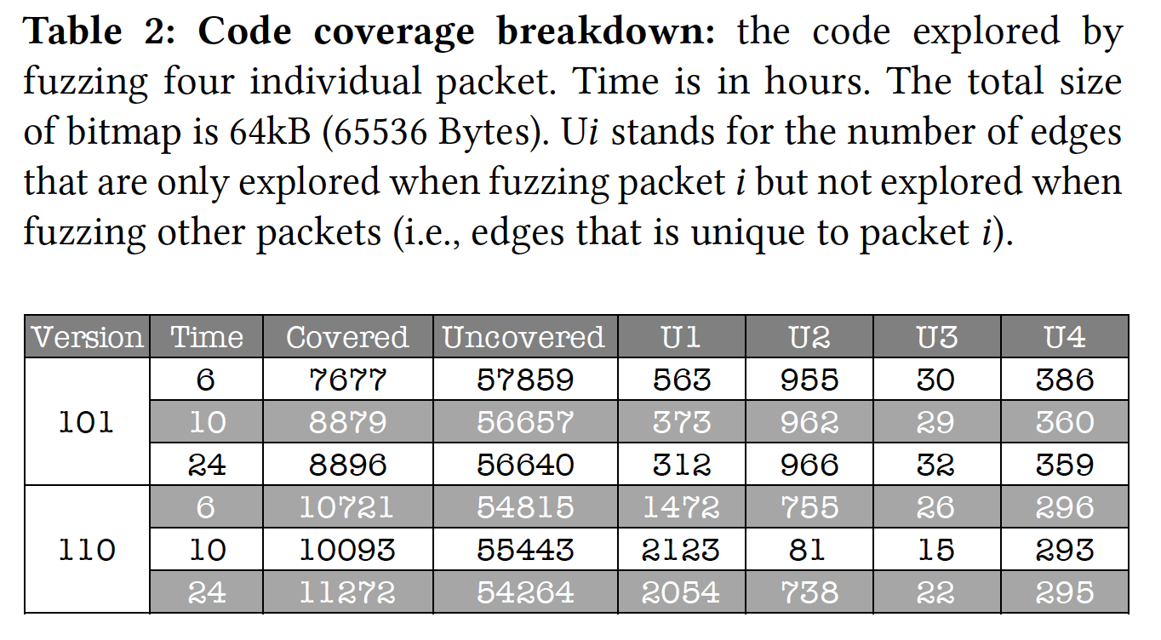
Stateful fuzzing
OpenSSL

Slide 17
Search Policy
Progression
Current state f1, when interesting p1 triggers new code coverage, trap f1 and fuzz p2
Regression
Current state f2, when fuzzing p2 is exhausted, step back to previous state f1, and continue fuzzing p1
DFS backtracking
f1 => f2 => f3 => f4 => f3’ => f2’ => f1’

Slide 18
Search Policy: what to monitor?
Key: variables that indicates state changes in the protocol
Indicators:
Code coverage
New packet flight
Packet change: packet type, length, or combined signature

Slide 19


Thank you!
N00014-17-1-2786 & N00014-15-1-2210

